Slide 1



The Role of Construction Experts in the Resolution of Disputes in Arbitration
Felipe Gutierrez, CCA, CRK, CFE, CIA, CRMA
NACA 2026 Conference
Circa Resort-Las Vegas
September 15 – 16

Slide 2
When can disputes take place?
Idea Concept
1
Planning & Design
2
Construction
3
Operation
4
Decommissioning
5
Project viability
Funding allocations
Stakeholder interests
Design changes
Budget overruns
Regulatory interpretations
Delays & schedule
Quality & workmanship
Contractual conflicts
Operational inefficiency
Maintenance responsibilities
Unmet performance metrics
Environmental liabilities
Regulatory compliance
Asset disposal methods

Slide 3

When a construction dispute reaches arbitration, what decides the outcome?
Contract language
Contemporaneous records
Credibility of witnesses
Quality of expert analysis
Tribunal’s ability to understand cause, effect, and value
Key message: Experts do not “win” cases. They help tribunals understand complex facts.

Slide 4
Learning Objectives
By the end, participants should understand:
Where experts fit in the arbitration process
How construction experts translate project records into opinions
Why audit evidence is critical to delay, cost, productivity, and fraud disputes
What makes expert evidence persuasive or vulnerable
How construction experts can prepare records that survive arbitration

Slide 5
Why Construction Disputes Need Experts
Construction disputes often involve:
Technical complexity
Long project histories
Thousands of records
Multiple causes of delay or cost growth
Commercial pressure and incomplete documentation
Differing interpretations of entitlement and damages
Expert role: Convert project complexity into disciplined, evidence-based analysis.

Slide 6
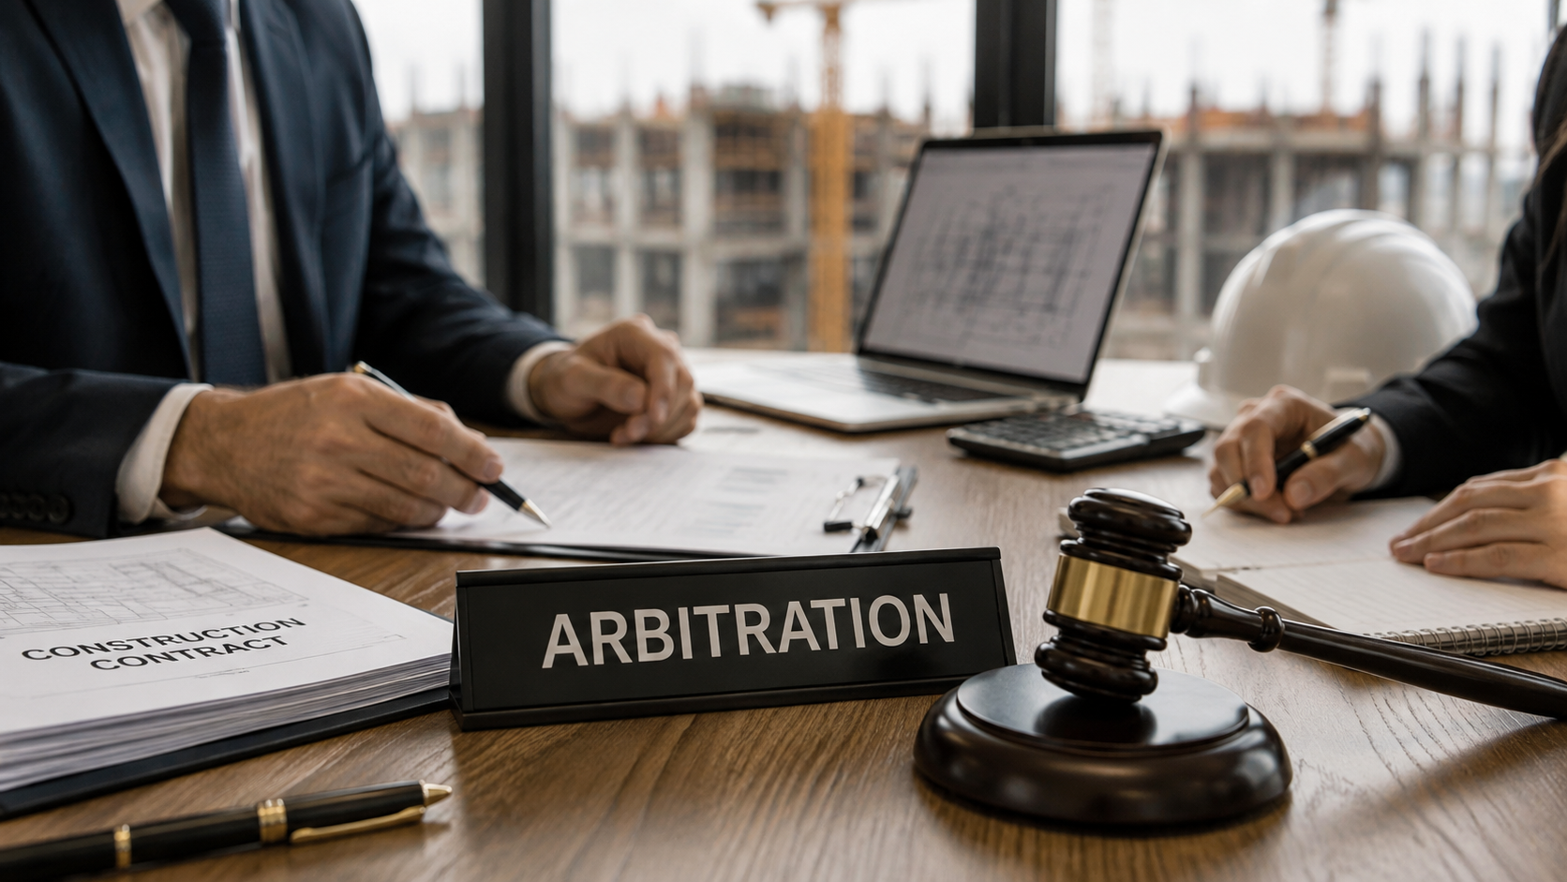
Arbitration Context
Arbitration is typically:
Private
Contract-based
Less formal than court litigation
Heavily dependent on written submissions and expert reports
Decided by one or more arbitrators
AAA notes that construction arbitration often involves complex technical issues and expert testimony. https://www.adr.org/industries/construction/

Slide 7

What the Tribunal Needs from Experts
Tribunals need help answering:
What happened?
Why did it happen?
Who caused it?
What was the contractual consequence?
How much did it cost?
Is the claimed amount reliable?

Slide 8
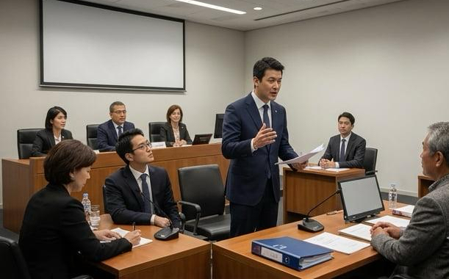
The Expert’s
Core Duty
The expert’s duty is to the tribunal, not merely to the party who retained the expert.
Good experts are:
Independent
Objective
Transparent
Methodologically consistent
Clear about assumptions
Calm under pressure
Willing to concede weak points

Slide 9
Types of Construction Experts
Common expert disciplines:
Delay / schedule analysis
Quantum / damages
Productivity / disruption
Engineering / design defects
Construction management
Forensic accounting
Cost audit / overbilling
Standard of care
Fraud and compliance

Slide 10

Party-Appointed vs Tribunal-Appointed Experts
Party-appointed experts
Retained by one party
Prepare expert reports
Testify and face cross-examination
Tribunal-appointed experts
Appointed by the tribunal
Assist the tribunal on specific issues
May be questioned by the parties
ICC rules expressly allow tribunals to appoint experts, define their terms of reference, and receive their reports.
(https://iccwbo.org/dispute-resolution/dispute-resolution-services/arbitration/rules-procedure/2021-arbitration-rules/?utm_source=chatgpt.com)

Slide 11
Where Experts Can Add Value Accross the Dispute Lifecycle
Typical lifecycle
Claim arises
Early assessment
Notice and entitlement review
Document collection
Expert scoping
Expert report
Rebuttal report
Joint expert process
Hearing testimony
Award
Best practice: Bring experts early enough to preserve evidence, but not so early that analysis becomes advocacy.

Slide 12

The Expert’s Starting Point: Records
Experts rely on:
Contract and amendments
Change orders
Pay applications
Schedules and updates
Daily reports
RFIs
Submittals
Meeting minutes
Cost reports
Invoices
Emails
Photographs
Audit workpapers
Construction audit records often become arbitration evidence.

Slide 13
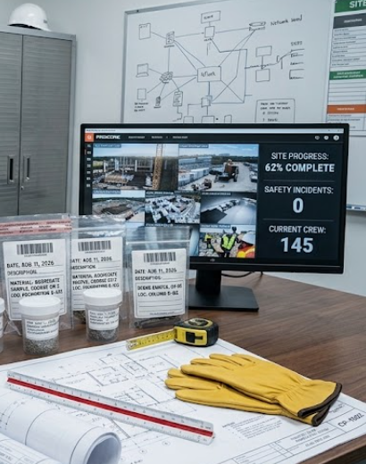

Contemporaneous Records Matter
Most persuasive evidence:
Created at the time of the event
Prepared in the ordinary course of business
Consistent across sources
Linked to cost, time, scope, and responsibility
Weak evidence:
Reconstructed after the dispute
Unsupported narratives
Spreadsheet-only claims
Missing source documents
Inconsistent coding

Slide 14

Delay Experts: Main Questions
Delay experts usually address:
Was the project delayed?
What was the critical path?
Which events caused delay?
Was the delay excusable?
Was the delay compensable?
Were there concurrent delays?
Did the contractor mitigate?

Slide 15
Delay Analysis: Practical Point
Delay analysis is not just comparing planned vs actual dates.
It requires:
Baseline schedule review
Update quality assessment
Critical path identification
Logic and duration testing
Event-to-impact linkage
Consideration of concurrency
There is no single universally mandated methodology for analyzing delay. The appropriate methodology depends on the contract, available contemporaneous schedules and records, timing of the analysis, nature of the delay, and the questions the tribunal must decide. ASCE 67-17 establishes guiding principles, while AACE 29R-03 provides a more detailed methodological taxonomy.
See appendix

Slide 16
Quantum Experts: Main Questions
Quantum experts usually address:
What costs were incurred?
Were they caused by compensable events?
Are they reasonable?
Are they supported?
Were they already paid?
Are markups contractually allowed?
Are claimed damages duplicative?

Slide 17
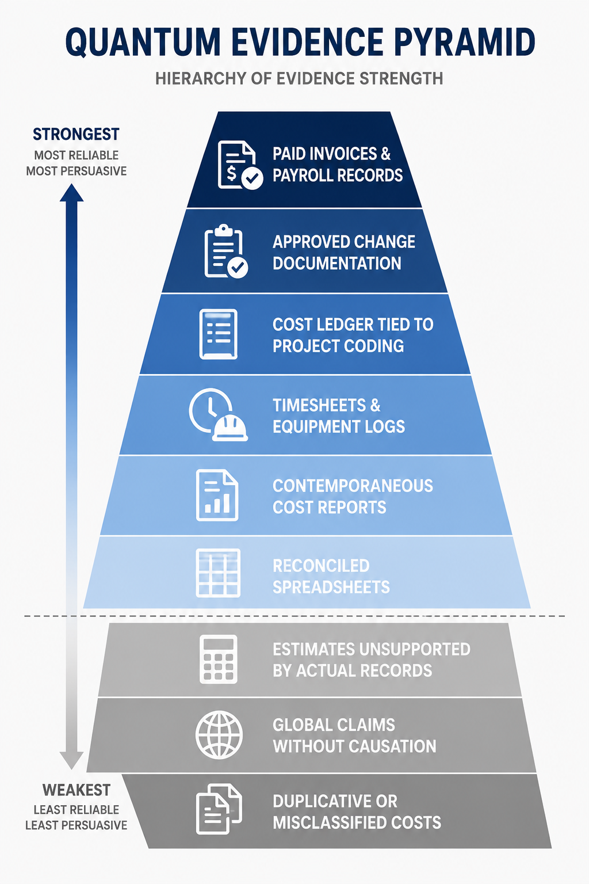
Quantum Evidence Pyramid

Slide 18

Productivity and Disruption
Disruption claims often involve:
Congestion
Trade stacking
Overtime inefficiency
Out-of-sequence work
Excessive changes
Restricted access
Rework
Learning curve impacts
Challenge: Proving causation between events and productivity loss.

Slide 19
Construction Auditors as Evidence Builders
Auditors help disputes by ensuring:
Cost coding is consistent
Change orders are traceable
Labor and equipment records are preserved
GMP/allowance/reimbursable costs are tested
Overbillings are identified early
Exceptions are documented contemporaneously
Good audit work can prevent disputes or strengthen resolution.

Slide 20
Common Expert Mistakes
Experts lose credibility when they:
Advocate rather than analyze
Ignore contrary evidence
Overstate certainty
Fail to reconcile data
Use methodology inconsistently
Do not understand the contract
Rely on counsel’s assumptions without testing them
Present conclusions the records cannot support

Slide 21

What Makes Expert Evidence Persuasive
Persuasive expert evidence is:
Simple without being simplistic
Tied to contract entitlement
Supported by records
Transparent in assumptions
Reproducible
Balanced
Clearly visualized
Responsive to opposing analysis

Slide 22
Expert Reports
A strong expert report includes:
Instructions received
Qualifications
Documents reviewed
Issues addressed
Methodology
Assumptions
Analysis
Conclusions
Limitations
Exhibits and calculations
IBA Rules address preparation and submission of expert reports and oral testimony in evidentiary hearings. (https://www.ibanet.org/MediaHandler?id=def0807b-9fec-43ef-b624-f2cb2af7cf7b )

Slide 23
Joint Expert Meetings and “Hot-Tubbing”
Common goals:
Narrow technical issues
Identify points of agreement
Clarify remaining disagreements
Reduce hearing time
Help the tribunal compare methodologies
Practical rule: Experts should agree where they can and explain precisely where they cannot.

Slide 24

Cross-Examination: What Gets Tested
Expect questions on:
Independence
Scope of instructions
Documents reviewed
Missing documents
Assumptions
Methodology
Alternative explanations
Arithmetic
Prior inconsistent opinions
Professional standards

Slide 25
Mini Case Example
Scenario: Contractor claims $35 million and 120 days due to owner-caused design changes.
Expert analysis should test:
Were changes documented?
Did changes affect critical path?
Were costs separately coded?
Were claimed labor hours actually caused by the changes?
Was there contractor-caused concurrent delay?
Were markups allowed?
Were amounts already paid through change orders?

Slide 26
Practical Checklist for Auditors
Before a dispute arises, ensure:
Clear cost coding structure
Complete pay application backup
Schedule updates preserved monthly
Change order logs reconciled
Meeting minutes finalized
RFIs and submittals tracked
Audit exceptions documented
Supporting documents retained
Privilege and confidentiality protocols respected

Slide 27
Key Takeaways
Experts help tribunals understand complexity.
Records usually matter more than opinions.
Causation is the bridge between entitlement and damages.
Independence is central to credibility.
Construction auditors can materially improve dispute outcomes before arbitration starts.

Slide 28
Final thought:
“In arbitration, the best expert opinion is not the most aggressive one. It is the one the tribunal can trust.”

Slide 29
Questions

Slide 30
APPENDIX
Framework | Relevance in U.S. disputes | What it covers
ANSI/ASCE/CI 67-17 – Schedule Delay Analysis | Very high | U.S. consensus standard specifically addressing construction delay analysis; includes 35 guiding principles concerning critical path, float, concurrency, responsibility for delay, acceleration, etc. ASCE itself describes it as a consensus industry standard. (SP360)
AACE RP 29R-03 – Forensic Schedule Analysis | Very high | Detailed taxonomy and methodology for retrospective forensic schedule analysis. AACE RPs are vetted technical reference guidance rather than mandatory standards. (web.aacei.org)
AACE RP 52R-06 – Time Impact Analysis | High, particularly during the project | Guidance for prospective Time Impact Analysis (TIA) of changes and delay events. Particularly relevant to contemporaneous extension-of-time analysis rather than purely retrospective forensic analysis. (web.aacei.org)
Society of Construction Law Delay and Disruption Protocol – 2nd Edition | Recognized internationally and sometimes referenced in U.S. disputes | Delay, extensions of time, concurrency, disruption and compensation. It is not a U.S. standard, but is an important comparative reference in international arbitration. (SCL)
U.S. Federal / GSA / USACE CPM and Time-Impact requirements | Very important on federal projects | Federal contracting requirements frequently require CPM scheduling and time-impact analysis for extensions. For example, GSA expressly requires extension requests to be based on an analysis of time impact using the project schedule as the baseline. (Acquisition.gov)
GAO Schedule Assessment Guide (GAO-16-89G) | High for auditors; not a forensic-delay standard | Ten best practices for determining whether a project schedule is reliable and high quality. Particularly relevant to the NACA audiencebecause it gives auditors a framework for testing the underlying schedule before that schedule is relied upon in a claim. (Government Accountability Office)

Slide 31


The presenter:
Felipe André Isoré Gutiérrez
CONEXIG
Founder & Manager Partner
M: +1 (786) 570-0186
T: +1 (305) 204-0919
T: +1 (888) 213-8012
felipegutierrez@conexig.com
LinkedIn:
Whatsapp: +1 (346) 755-2435

