Slide 1

Fraud and Its Many Sharp Edges:
Often Not Your Typical Cocktail Party Chatter
2024 NACA Conference
DURHAM CONVENTION CENTER- DURHAM, NC
September 10 – 11, 2024

Slide 2


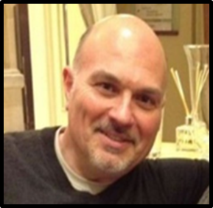
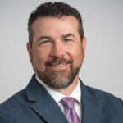
Co-Presenters:
Edward Travers II, Manager, Internal Audit
BXP (formerly Boston Properties)
Kenneth Brzozowski, Director, Audit & Advisory Services
Talson Solutions

Slide 3
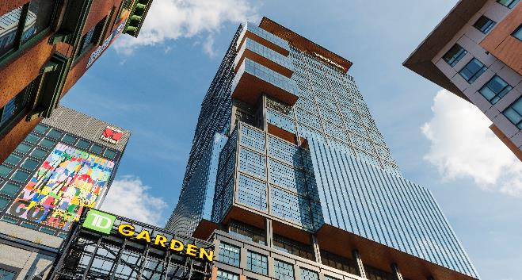
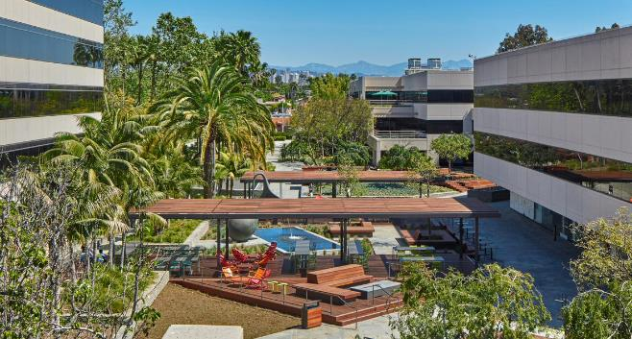
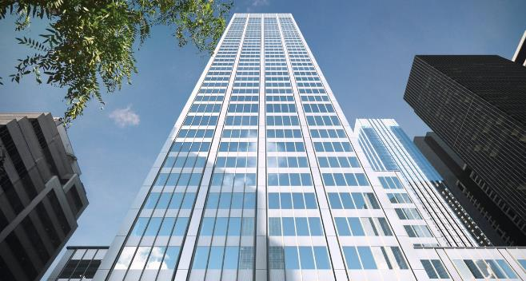
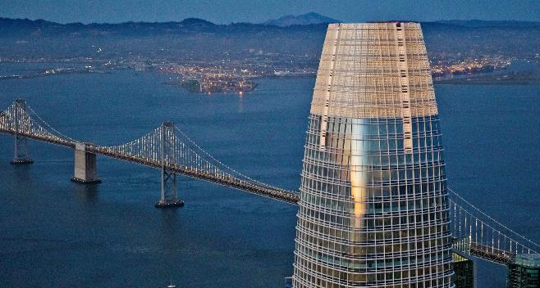
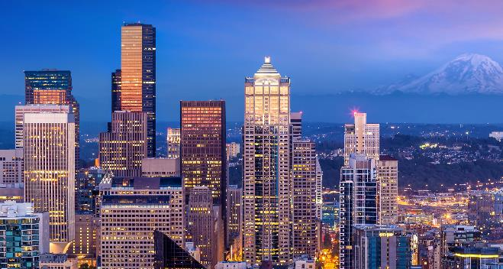
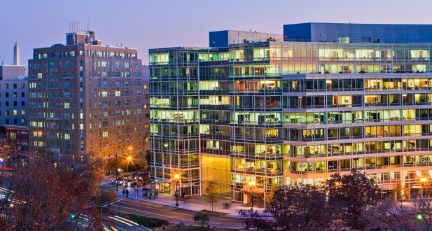
BOS
LA
NY
Co-Presenters:
Edward Travers II, Manager, Internal Audit
BXP (formerly Boston Properties)
Kenneth Brzozowski, Director, Audit & Advisory Services
Talson Solutions
SF
NY
DC

Slide 4
The Objective of this Presentation:
Defining what Fraud is and what it isn’t
Figuring out what you are protecting when mitigating fraud
How do you protect yourself from fraud?
What are some case studies on what BXP does to mitigate our risk
5. Fraud Data: 2024 REIT Audit Directors Conference Summary Slides

Slide 5
Let’s Define Fraud.
What is it?
What is it Not?
Where does it come from?

Slide 6
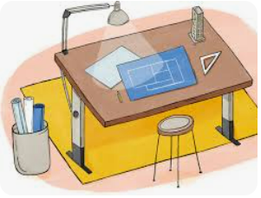
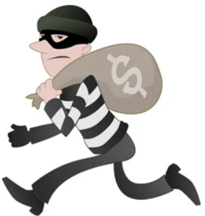


What is the definition of Fraud?
Wrongful and criminal deception intended to result in financial or personal gain.
Is that different than Theft?
The act of stealing. The felonious taking and removing of personal property.

Slide 7
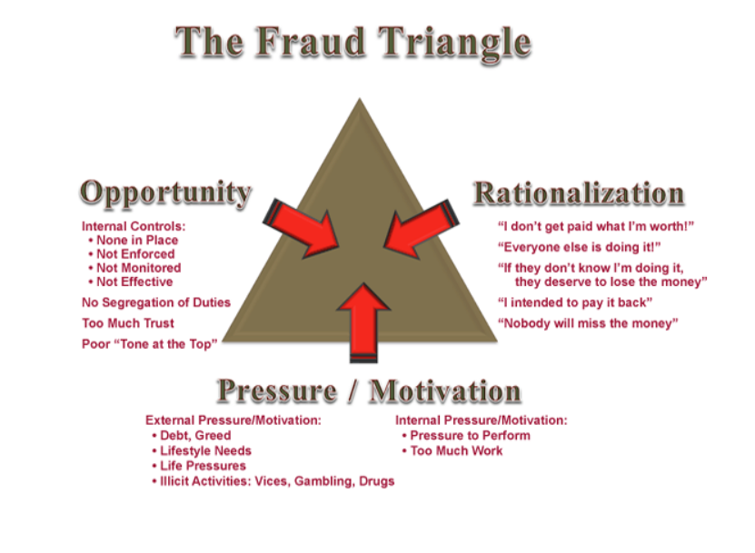
Now that we know the difference between Fraud and Theft, what do you need to call it Fraud?

Slide 8
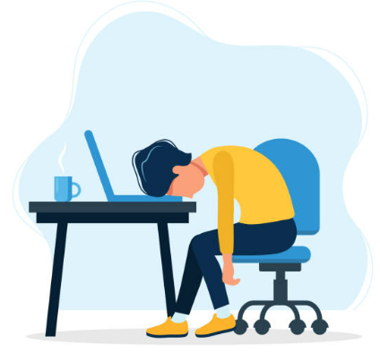

How does Fraud Happen?
While we were sleeping?! Not just literally but most important figuratively!!!
d
Opportunity
Internal Controls
  None at all
  Not Enforced
  Not Monitored
  Not Effective
No Segregation of Duties
To Much Trust
Poor “Tone at the Top”
Do you remember this???

Slide 9

How does Fraud Happen?
When we are not listening to our employees, peers, industry chatter, anyone in your company?
d
Rationalization
“I don’t get paid what I’m worth”
“Everyone else is doing it”
If they don’t know I’m doing it, they deserve to loose the money”
“I intended to pay it back”
“Nobody will miss the money”
Do you remember this???

Slide 10

How does Fraud Happen?
When we are not observing behavior. Watching how individuals act, react, discuss how the see things, etc…
d
Motivation (pressure)
External
  Debt
  Greed
  Lifestyle Needs
  Life Pressures
  Illicit Activities
  Vices
  Gambling
  Drugs
Internal
Pressure to perform
Too Much Workt
Do you remember this???

Slide 11
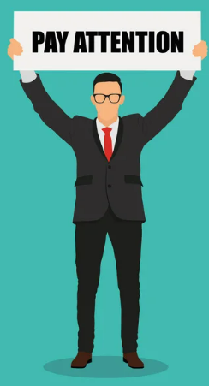
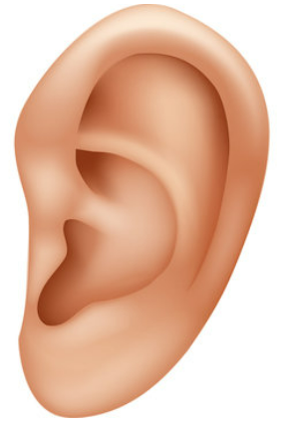

How do I mitigate this? How to I prevent this?
When you have no controls.
When we are not listening.
When are not watching.
d

Slide 12
Opportunity
Rational
Motivation
Management Standing Watch:
Meet with supervisors
Ask questions
Get true, full, complete answers
Understand answers
Make your presence known
Let them trust you
Listen to Employees:
How do them respond open
topics and things outside work
What are their interest (if shared)
Are they generally happy?
Are they generally not happy?
Do they share their spend interest?
Publications, News, Peers:
Industry publications
Newspapers
Television news
Peer companies
Industry chatter
A lunch with others

Slide 13


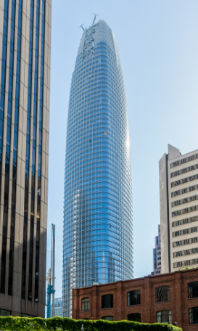
What are you protecting by mitigating fraud?
1
2
3
EMPLOYEES
YOUR NAME / REPUTATION
ASSETS

Slide 14
1
1 + 2 + 3 =
Financial Protection
Stolen Money
Loss of Future Business
Potential Law Suites
Loss Employees
Higher Cost of Doing Business
Higher Rates (bank, insurance, etc.)

Slide 15
What does the largest REIT in the US do to mitigate fraud:
Company built on policies and procedures
Top Down Management Style of everyone is equal
Companywide built on One-Team mentality
Perform Annual Fraud Risk Assessment
Prepare an Annual Fraud Schemes and Scenario Report
Review Controls annually
Identify team members that are company non-conforming
Intellectual Intelligence
  Education
  Word on Street
Emotional Intelligence
  Listening with more colors & not just black and white
  Judgement vs. what you know vs. what you don’t know
  Gut feeling
  Validating facts vs. Hearsay

Slide 16
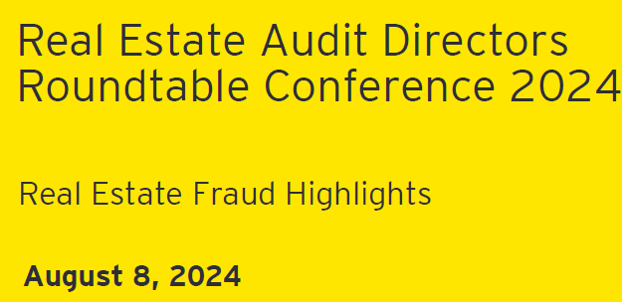
Some Additional Fraud Data

Slide 17
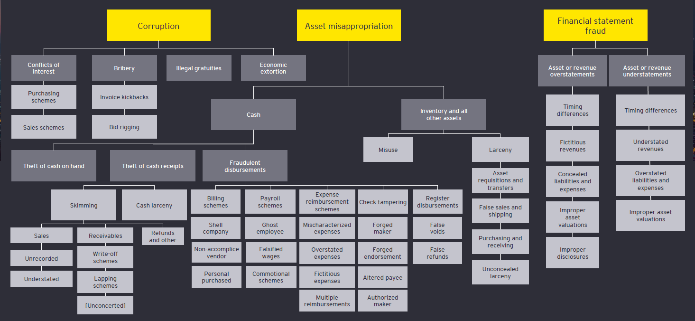
Fraud Tree Categories

Slide 18
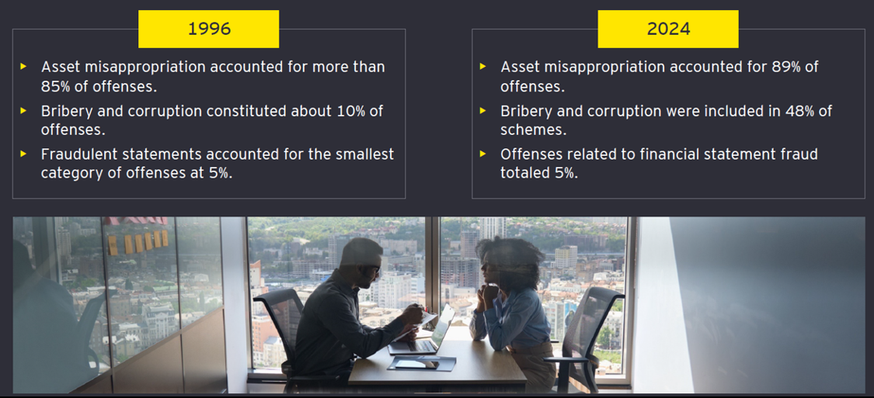
Losses by Fraud Tree Category

Slide 19
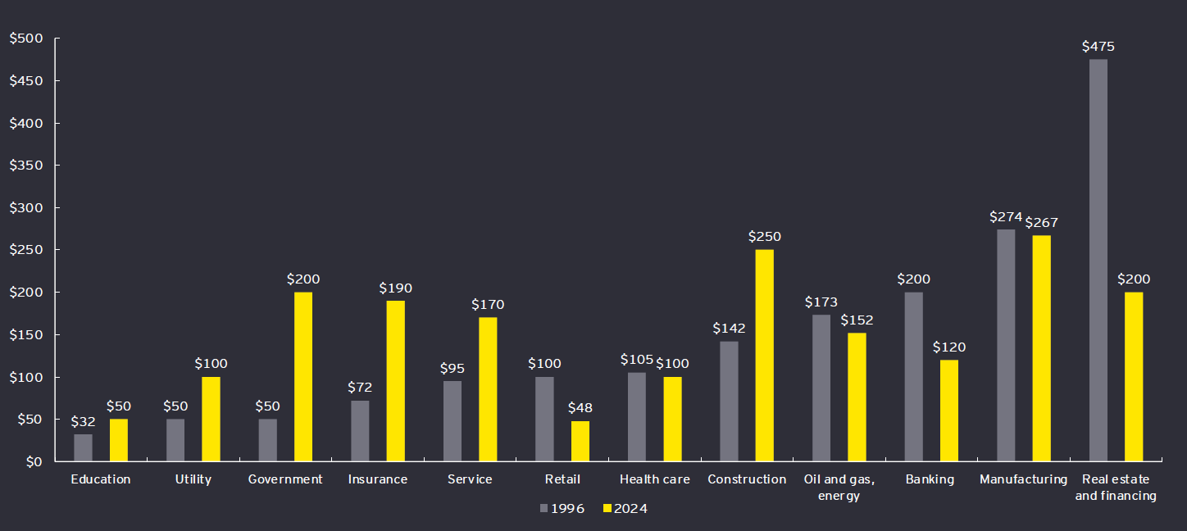
Median Loss by Industry (in (US$) Thousands)

Slide 20
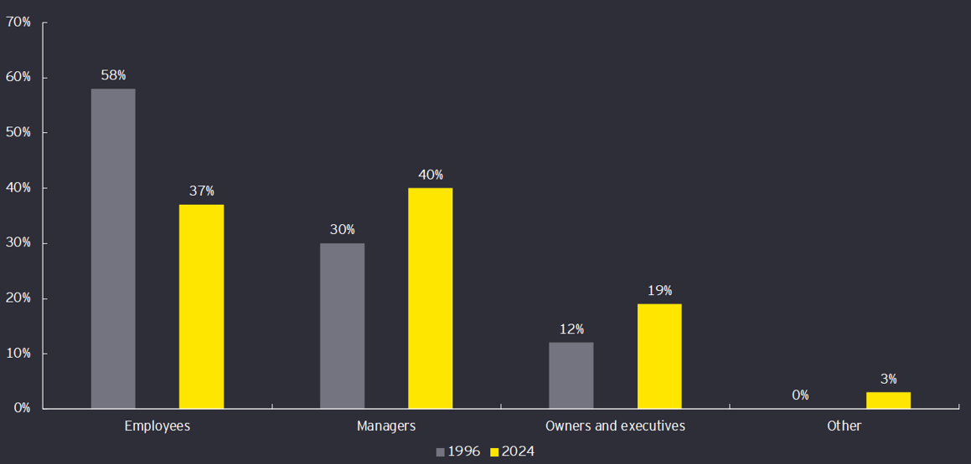
The Perpetrator’s Role

Slide 21
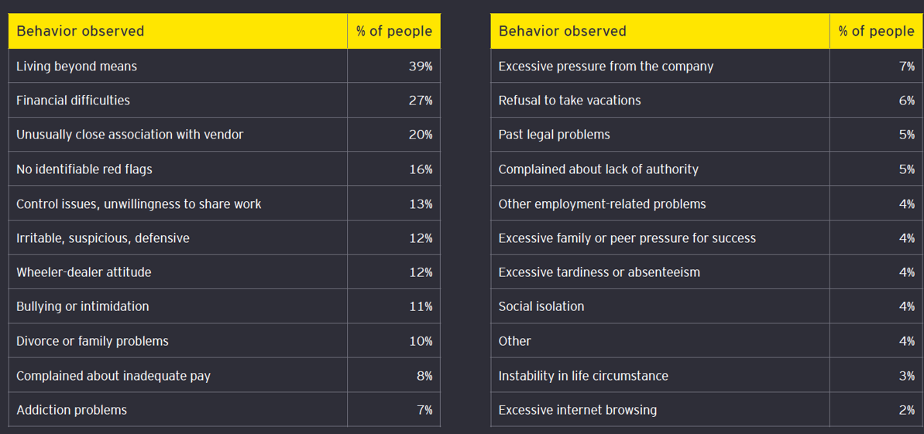
Behavioral Red Flags Displayed by Fraudsters

Slide 22
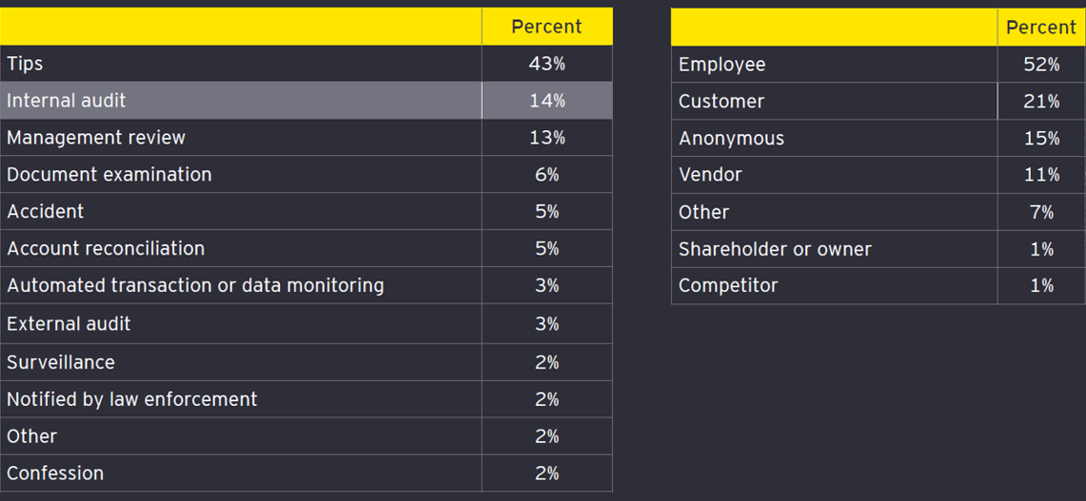
How Fraudsters Were Caught

Slide 23
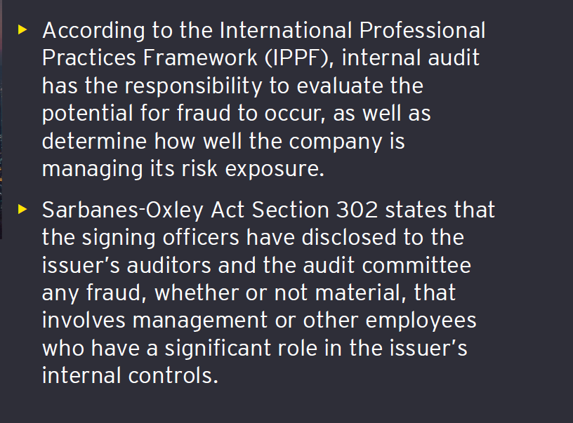
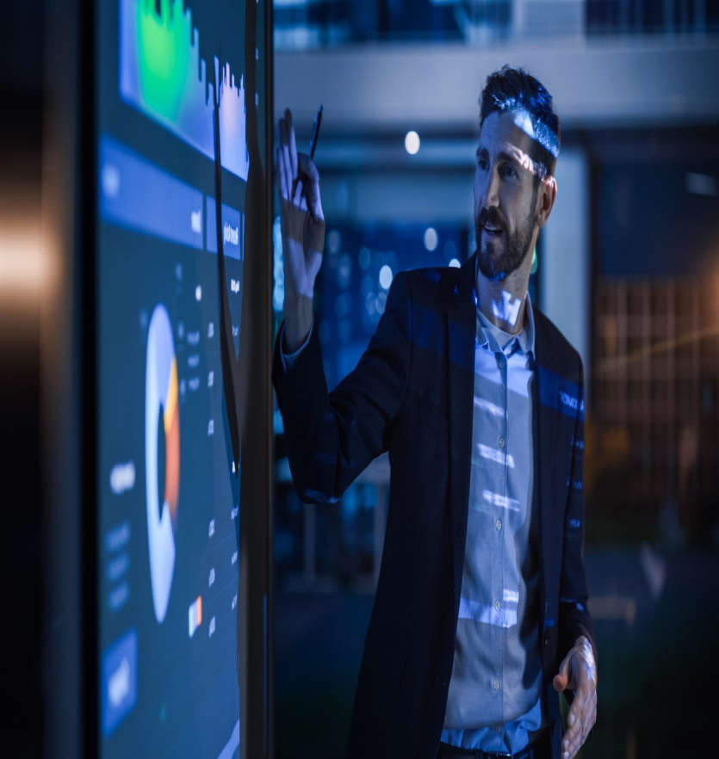
Why a Fraud Risk Assessment (FRA)?

Slide 24
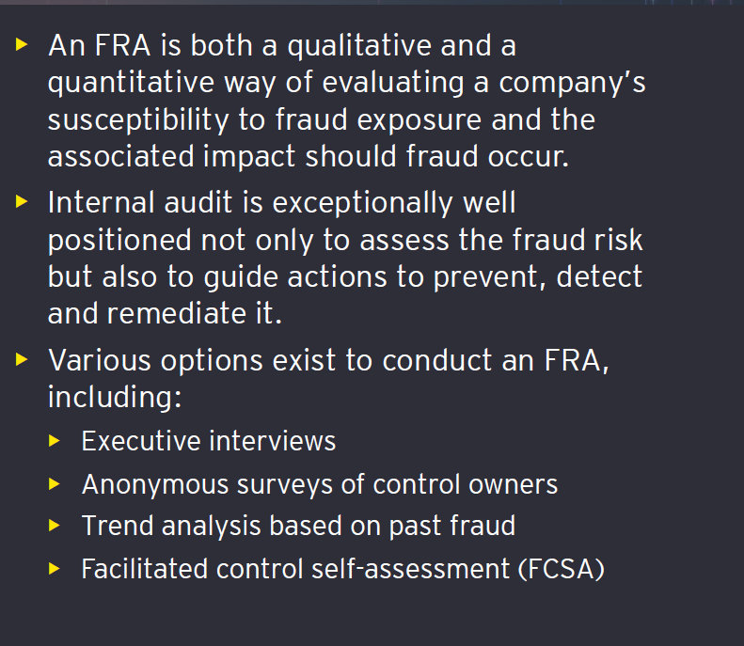

The FRA Process

Slide 25
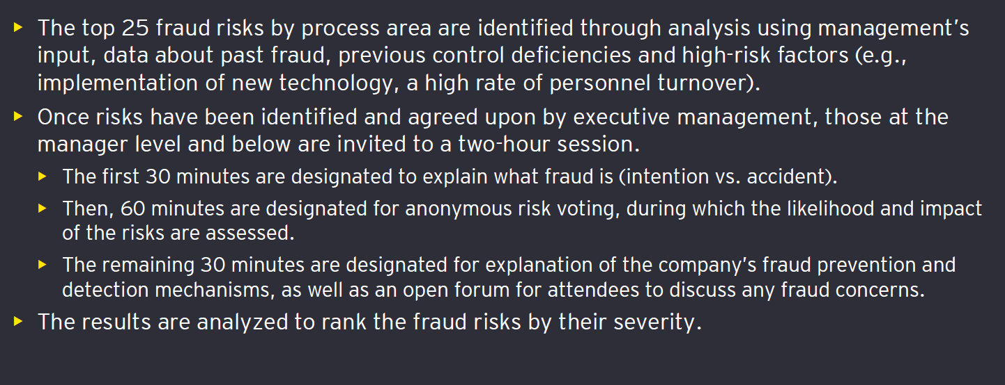
How FCSA Sessions Work

Slide 26
Questions?

